Slide 1


Getting the Messages Across

Slide 2
Фонетическая зарядка
write, wrong, wrist, wrap
wheat, wheel, whistle
ancient, communication, destination, efficient
announce, throughout, without, shout

Slide 3
Речевая зарядка
Are you a talkative person?
How often do you send massages?
Where do you prefer to get information from?
Do you prefer to talk alive with your friends or by phone?
How often do you watch TV?
Do you surf the Internet?

Slide 4
«The one who controls information owns the world»

Slide 5
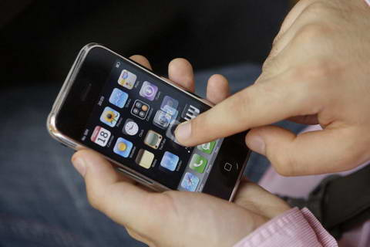
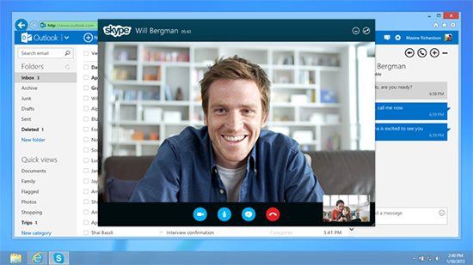

How do you prefer to contact distant friends?

Slide 6
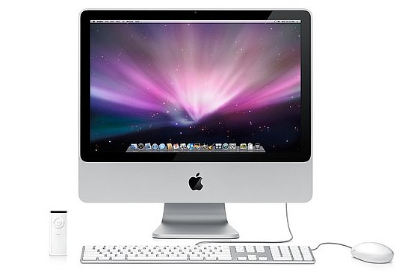

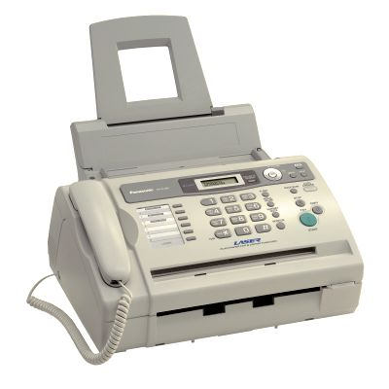
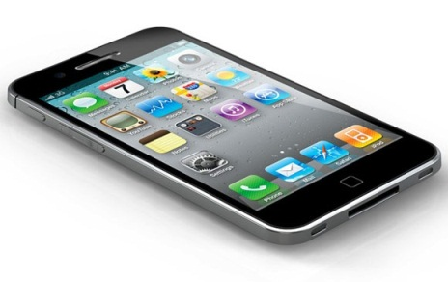

We can communicate with each other by
computer
Internet
Fax
Telephone
E-mail

Slide 7
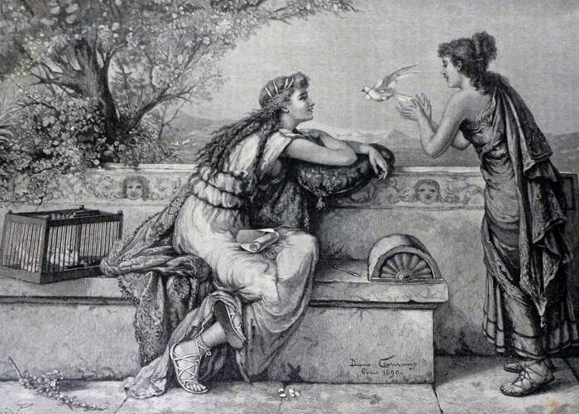
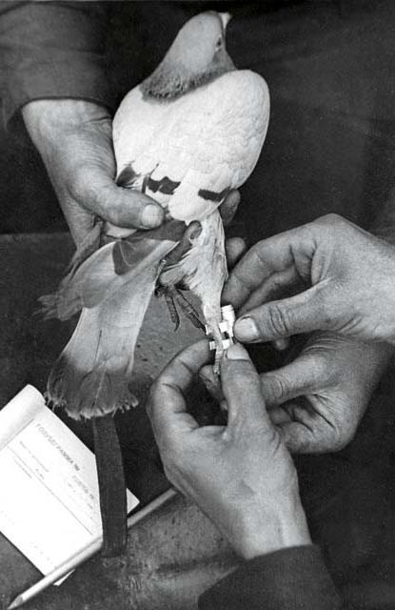
Until the 19th century the pigeon was the fastest means of communication.

Slide 8
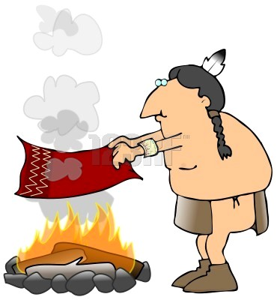

North American Indians used smoke signals to send massages.

Slide 9
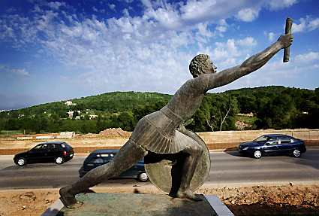
A messenger running to Rome.

Slide 10
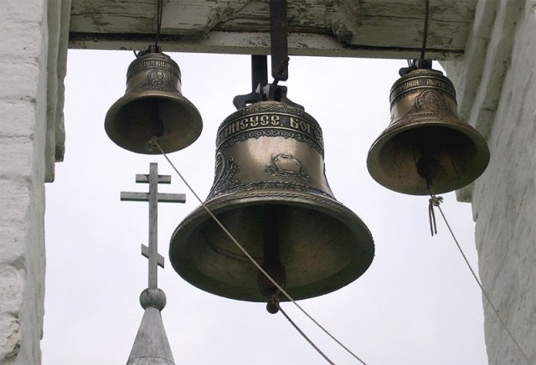
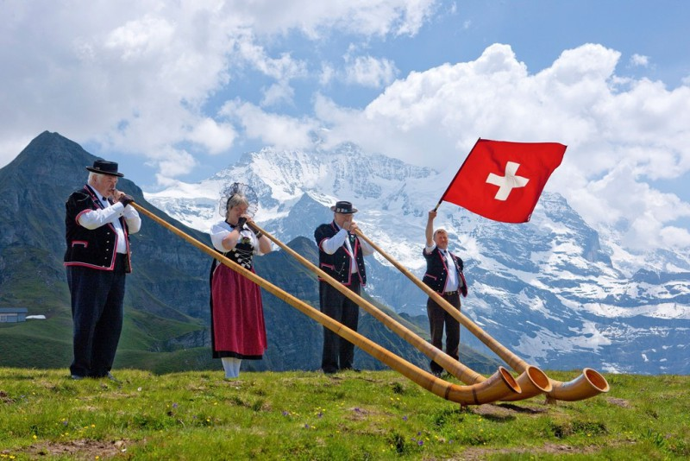
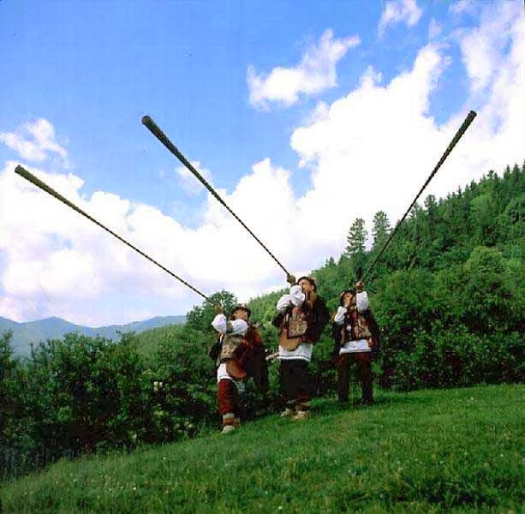
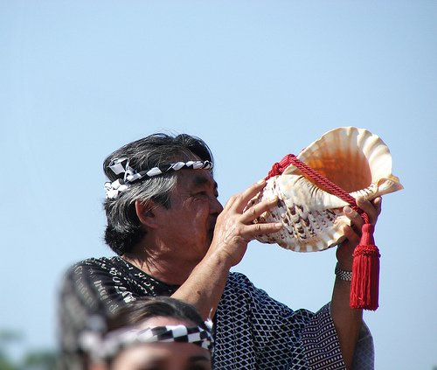
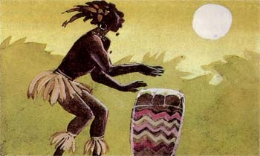
Messaging with the help of …

Slide 11
Наиболее частотные суффиксы:
Существительные: -ance, -ence, -dom, -er, -or, -ess, -hood, -ing, -ion, -sion, -tion, -ist, -ment, -ness, -ship, -uer, -ity
Прилагательные: -able, -ible, -al, -ant, -ent, -ese, -ful, -less, -ian, -ic, -ish, -ite, -ive, -ous, -y

Slide 12
Questions:
1.How do people communicate in the past?
2.How do you communicate with your friends?
3.If we had no modern means of communication, which of the methods would you choose and why?

Slide 13

Thanks a lot for your work.
You really take the cake today.

